Slide 1
To the Cosmos and Beyond
Adrian Brink
Decentralize Singapore, 2018-04-05

Slide 2
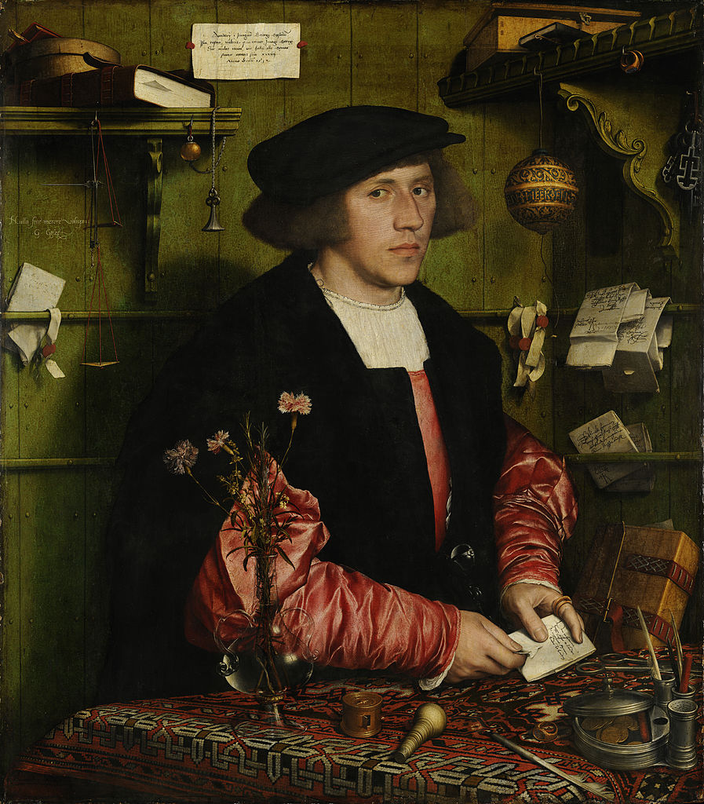
The Story of Hans
Gold & Silver Merchant
Inherited the business from his parents
Located in West Germany (early 20th Century)

Slide 3
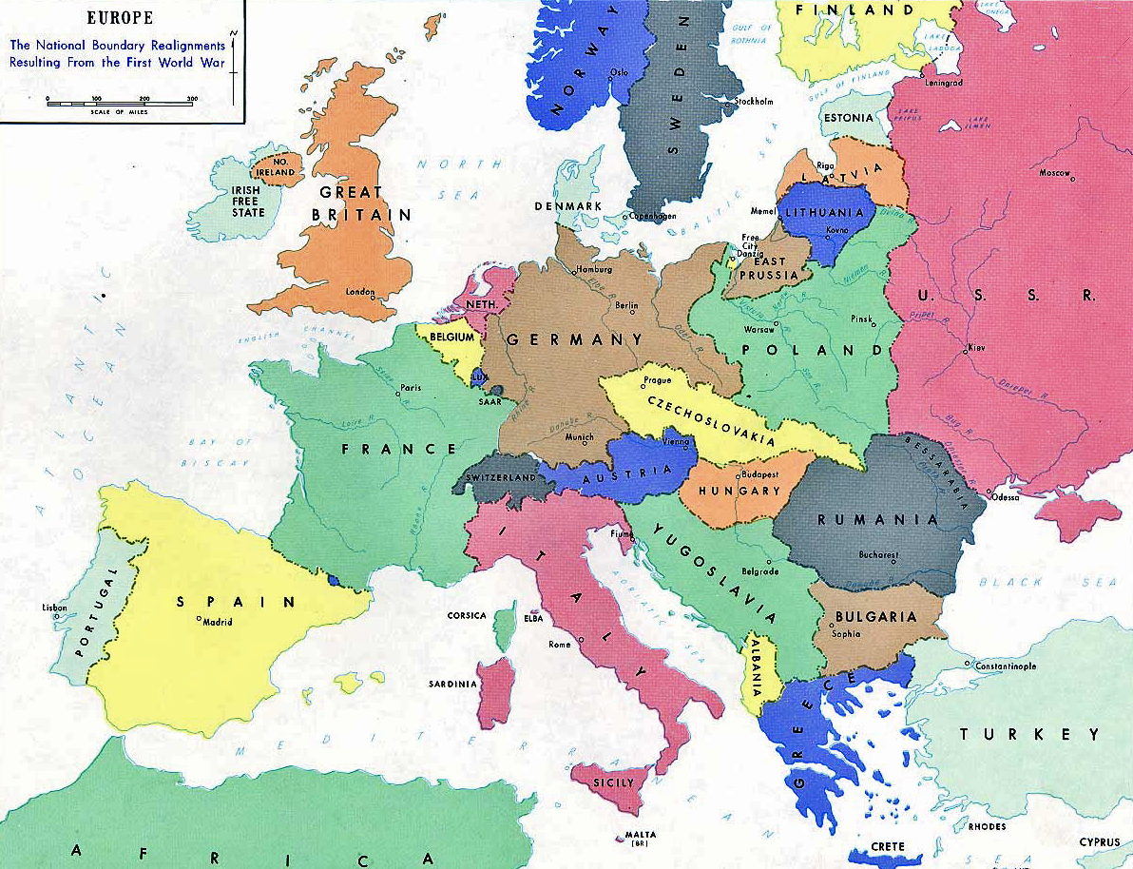
EUROPE in the 20th Century
28 Isolated Nation States
High cost in cross border commerce

Slide 4
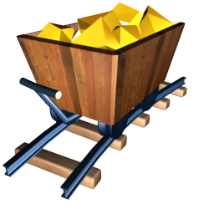
The Story of Hans
The Story of Hans
Gold and Silver suppliers are from West Germany
But the highest demand is in France and other countries

Slide 5

The Story of Hans
The Story of Hans
Expensive, time-consuming and sometimes dangerous process to move goods from one Nation State to another

Slide 6
BLOCKCHAINS Today
The Story of Hans
The Nation States of the 20th century are the blockchains in our current ecosystem
dApp developers ~ merchants
BITCOIN
ETHEREUM

Slide 7
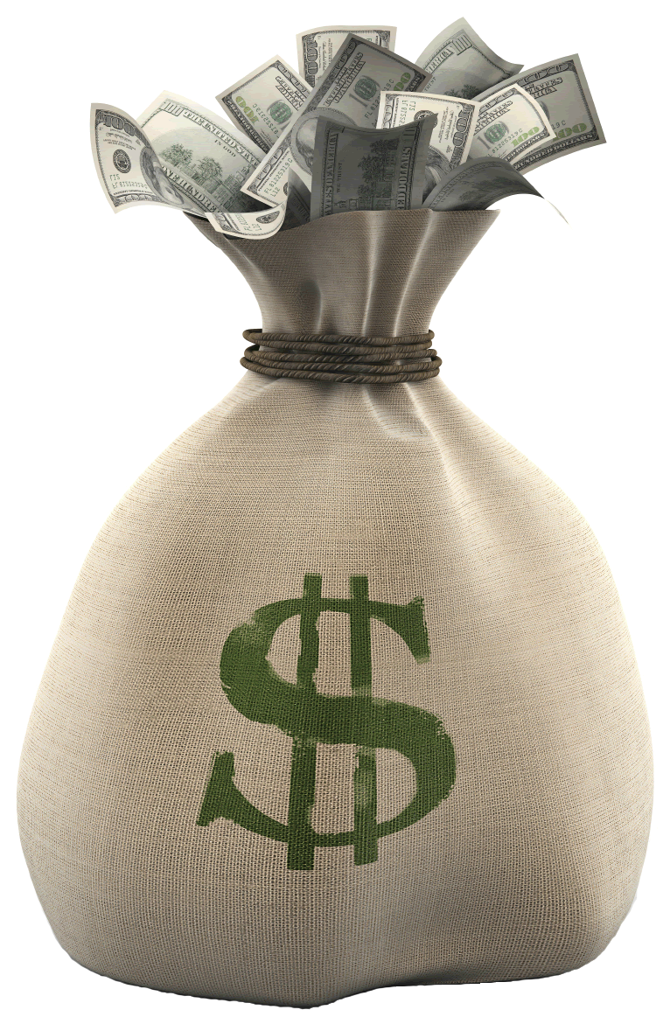
BLOCKCHAINS Today
The Story of Hans
Expensive, time-consuming, risky and mostly an impossible to access tokens, NFAs or other complex objects from two different communities
BITCOIN
ETHEREUM

Slide 8
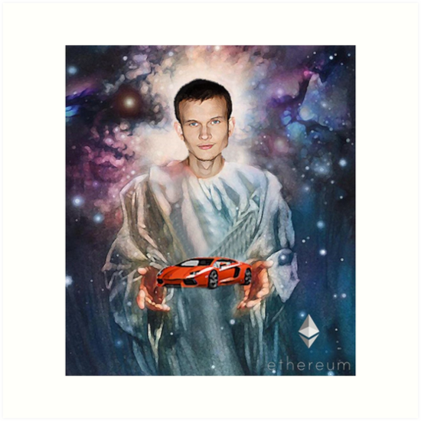
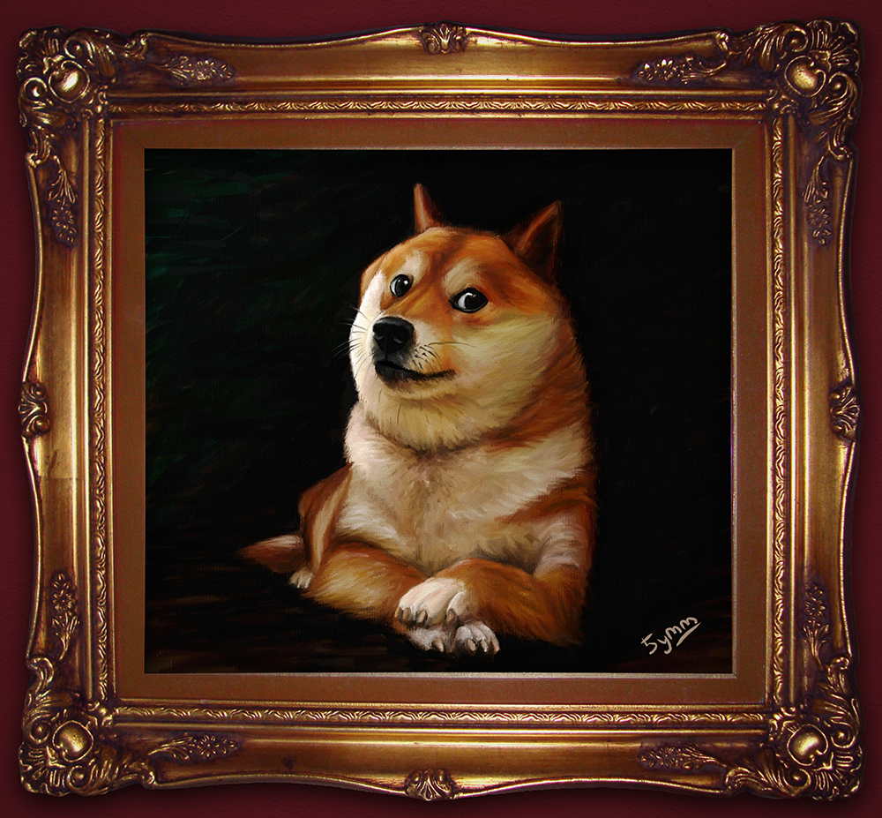


Where is the liquidity?
The Story of Modern Hans
Modern day Hans is building a decentralized application
To Decentralize or not Decentralize?

Slide 9


The Story of Modern Hans
ETH? Lol no
One of biggest users would like to use her BTC to buy and sell digital goods. For her it is an extremely
expensive, time-consuming and risky process to participate in Hans' DEX
Pls buy some ETH
Decentralized Exchange
Bitcoin Maximalist User

Slide 10
But what if we could turn siloed blockchains into a single free market?

Slide 11
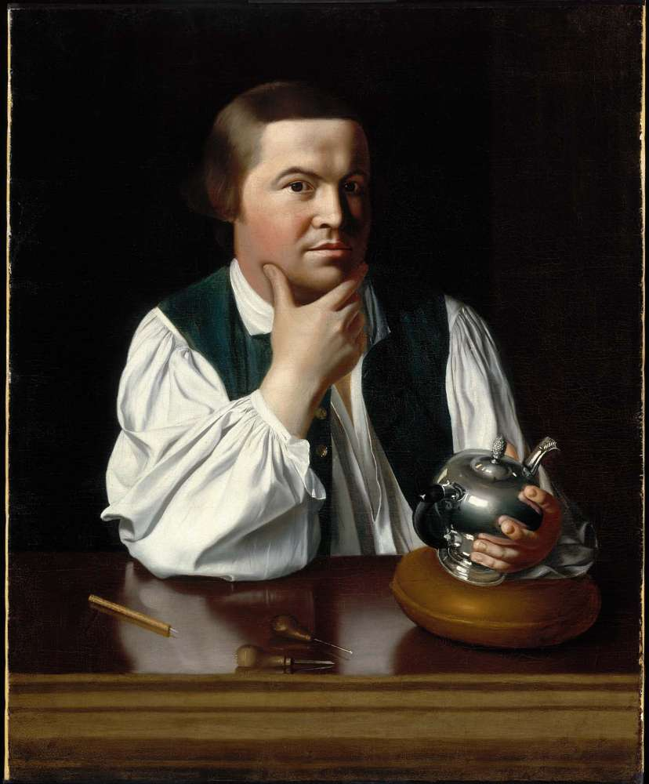
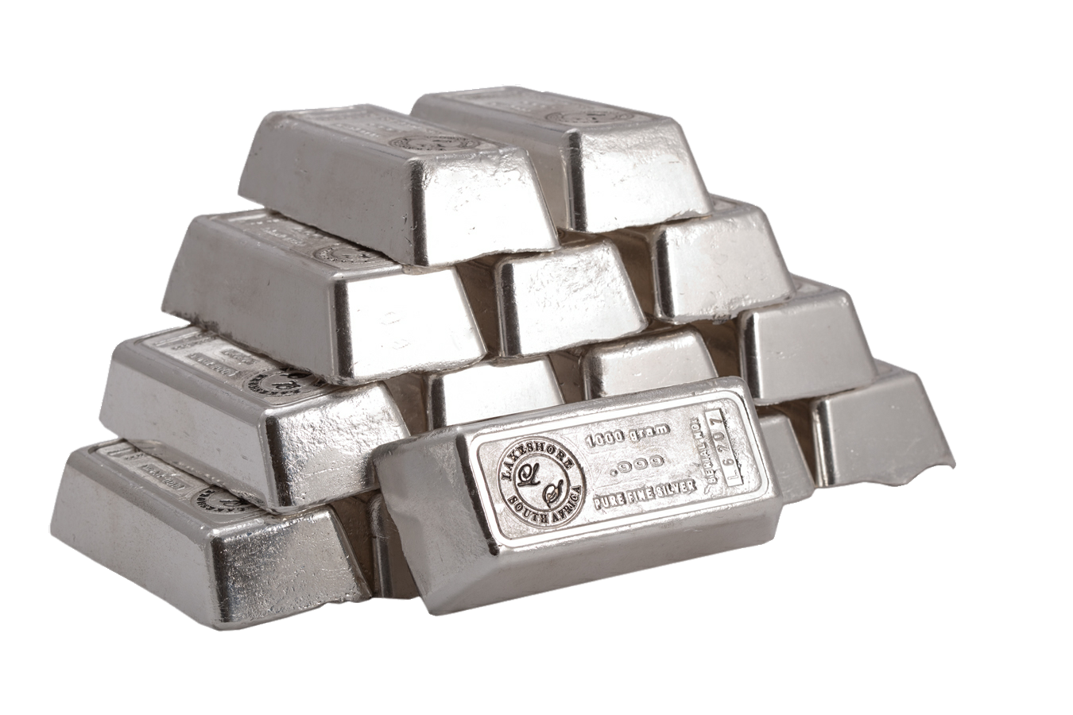
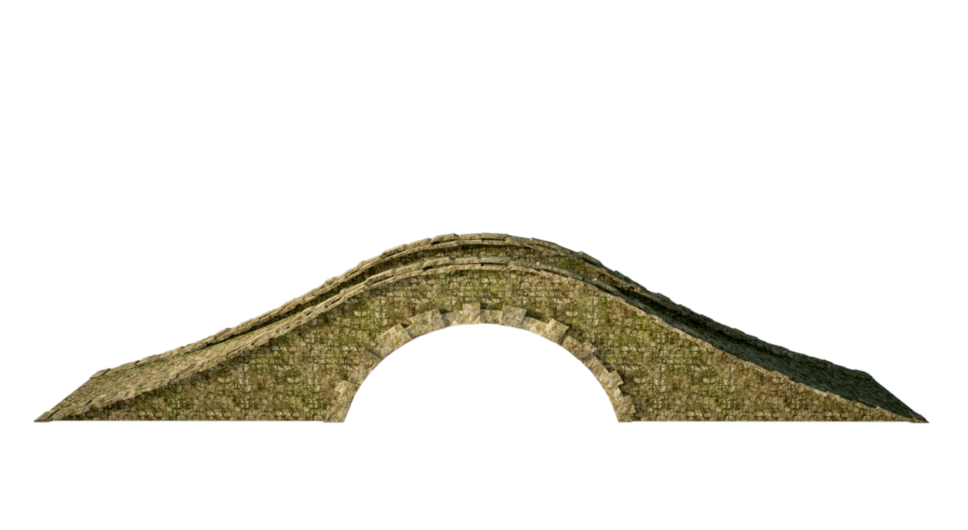
The IBC PROTOCOL
Germany
France
When Hans moves an ounce of sterling silver from Germany to France it does not change ownership
IBC
Hans the Merchant
A French Craftsman

Slide 12
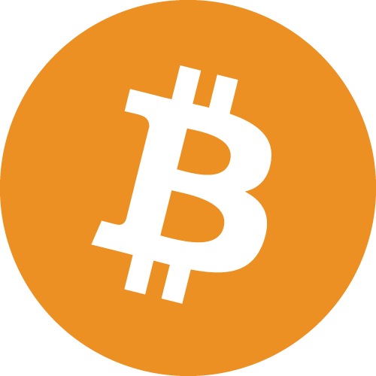
The IBC PROTOCOL
Moving tokens, NFAs or complex objects over IBC requires that you trust the involved protocols, but it does not require you to trust a central exchange or any other third party
Ethereum
Bitcoin
COSMOS HUB
1
ETH
1
BTC
Decentralized Exchange
Bitcoin Maximalist User

Slide 13
IBC allows the consensus of some protocol to
have ownership over some asset on another protocol

Slide 14
The COSMOS Hub
The COSMOS HUB
The Cosmos Hub is the equivalent of the European Single Market

Slide 15
So what is your choice?
Become an isolated nation state,
or be part of
a larger single market?

Slide 16
Any Questions?
Adrian Brink
@adrian_brink
https://cosmos.network/

